Slide 1
Electroencephalography Frequency Analysis
Taylor Baum

Slide 2
Electroencephalography

Slide 3
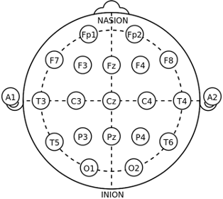
Electroencephalography detects electrical activity in the brain.
Notes:
https://www.istockphoto.com/photos/eeg-test

Slide 4
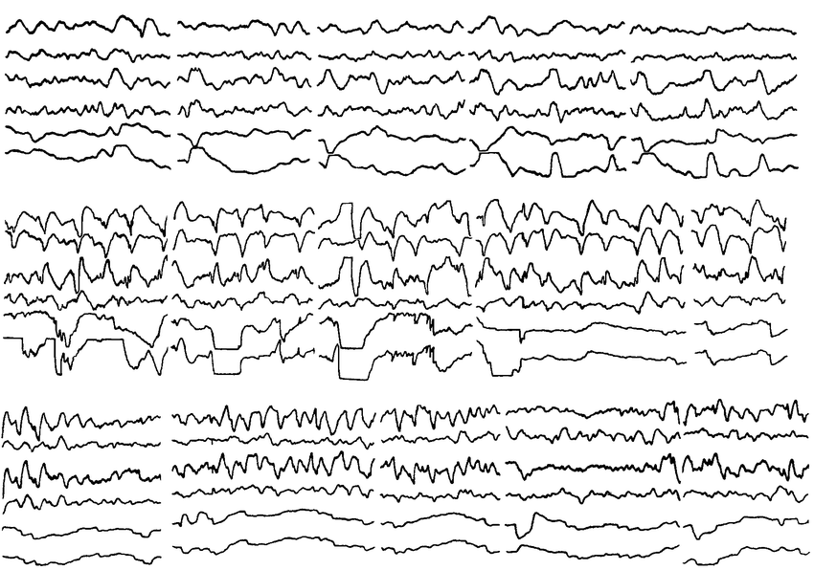
Let’s try and understand what exactly an electroencephalogram is detecting!
Notes:
https://www.researchgate.net/figure/EEG-and-EOG-responses-to-visual-stimuli-a-red-spot-and-a-black-and-white-contrasting_fig1_226078506

Slide 5
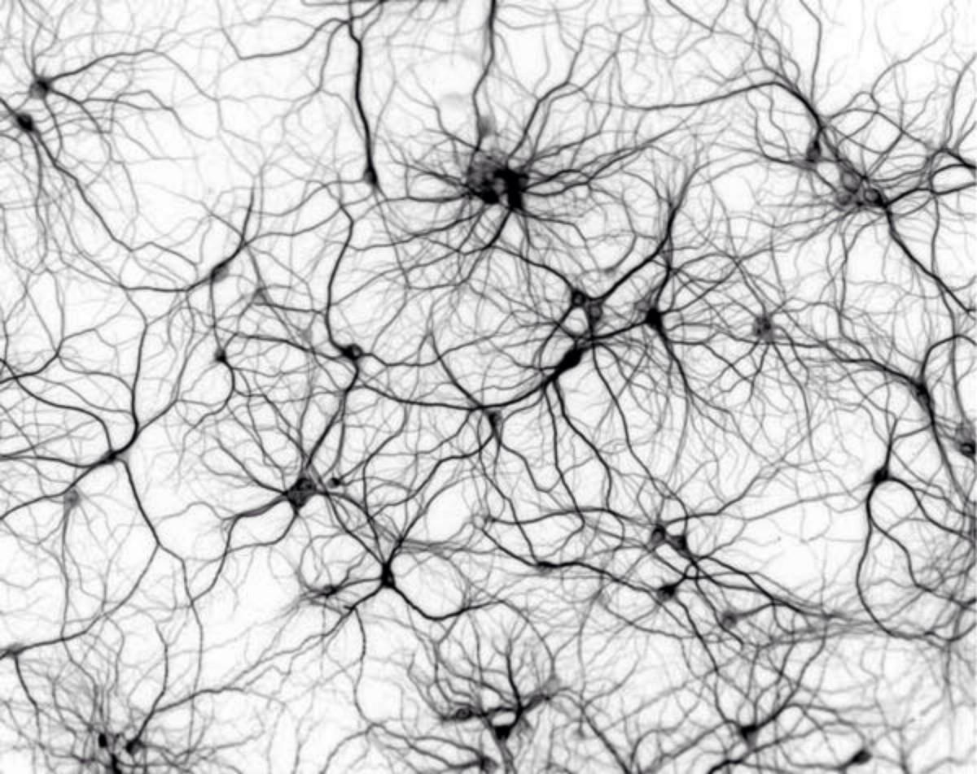
In the brain, we have neurons that are oriented in all different directions, and they transfer information between one another through electrical signals.

Slide 6
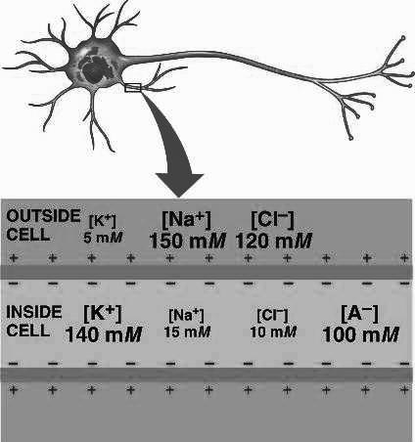
The electrical potentials contained in neurons are generated by differences in concentrations of charge across cell membranes known as ion gradients.
Notes:
https://www.https://bio1152.nicerweb.com/Locked/media/ch48/gradients.html.com/watch?v=Jk_9IhHVOTk

Slide 7
First, let’s think about voltage and current, both which result from the ion
gradients.
V = IR
Voltage = Current * Resistance

Slide 8
Voltage (V in Ohms) is the difference in electrical potential between any two
points in an electrical circuit.
V = IR
Notes:
https://battlebornbatteries.com/amps-volts-watts/

Slide 9
Current (I in amps) is the speed or rate at which the electrons flow through a resistor.
V = IR
Notes:
https://battlebornbatteries.com/amps-volts-watts/

Slide 10

To reemphasize the definition of voltage and current, we consider a
water analogy.
Notes:
https://battlebornbatteries.com/amps-volts-watts/

Slide 11
For water to move through a hose (current to flow), there needs to be a difference in pressure (voltage) between two locations in the pipe.
High Pressure
Low
Pressure
Notes:
https://battlebornbatteries.com/amps-volts-watts/

Slide 12
If there is no difference in pressure (voltage), then there is no flow (current) through the pipe.
Low
Pressure
Low
Pressure
Notes:
https://battlebornbatteries.com/amps-volts-watts/

Slide 13
The existence of the pipe is the resistance to flow.
Low
Pressure
Low
Pressure
Notes:
https://battlebornbatteries.com/amps-volts-watts/

Slide 14
So, we can account for all three components of ohm’s law here.
V = IR
Notes:
https://battlebornbatteries.com/amps-volts-watts/

Slide 15
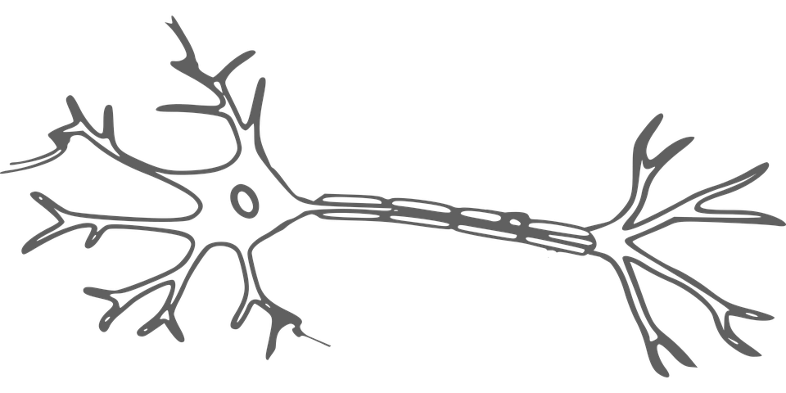
This concept is equivalent for electrical signals in neurons.

Slide 16
There needs to be some difference in charge concentration between two points in the neuron for electrical charge to flow (current).
Large Positive Charge
High Pressure
Low
Pressure
Small Positive Charge
or Negative Charge

Slide 17
Think of this flow of charge as a transfer of information. With no flow, there is no information being transferred.
Large Positive Charge
High Pressure
Low
Pressure
Small Positive Charge
or Negative Charge

Slide 18
Any questions about:
electrical signals
voltage
current
neuronal communication

Slide 19
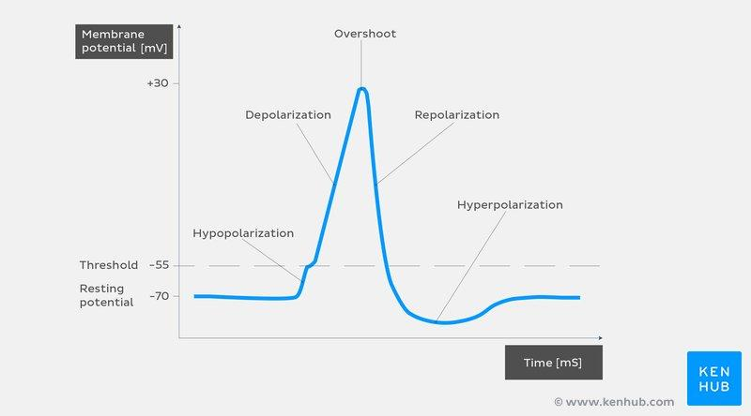
An action potential is when the membrane voltage of a neuron gets positive
enough that a wave of positive ions moves through the neuron.

Slide 20
In order for flow or an action potential to happen, a big enough membrane potential or difference in charge is needed.

Slide 21
EEGs don’t detect the action potential, but instead detect charge build-up in the extracellular space resulting, in the excitatory case, from the hypopolarization of the intracellular space.

Slide 22
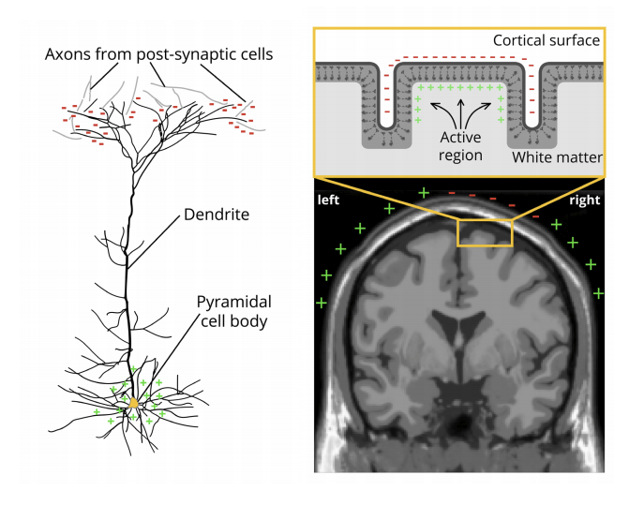
More generally, EEGs detect the build up of charge leading either to a neuron firing (Excitatory Postsynaptic Potential EPSP) or a neuron becoming less likely to fire (Inhibitory Postsynaptic Potential IPSP).

Slide 23
Let’s consider the Excitatory Postsynaptic Potential in a cell that is oriented
on the cortex according to the figure below.

Slide 24
For EPSPs, the post-synaptic potential of a neuron must cross a threshold
of -55 mV before the neuron will fire.

Slide 25
Before a neuron reaches that -55 mV threshold, there are positive ions rushing
into the neuron increasing the membrane potential and creating a negative
charge outside of the cell.

Slide 26
In a portion of a neuron that is away from the negative extracellular region, those positive ions are flowing out of the cell, creating a positive charge externally.

Slide 27
This difference in charge should remind us of what we mentioned earlier.
Large Positive Charge
High Pressure
Low
Pressure
Small Positive Charge
or Negative Charge

Slide 28
While this difference in charge eventually leads to an action potential, it is the existence of the difference in charge that the EEG picks up.

Slide 29
The single electrical dipole created in one neuron isn’t strong enough for an
EEG to detect it.

Slide 30
But, there are special neurons near the surface of the brain called pyramidal
neurons that are all oriented in the same direction.
Notes:
https://www.mayoclinic.org/tests-procedures/eeg/about/pac-20393875

Slide 31
So instead of single neuron recordings, we look at the summed activity of many pyramidal neurons.

Slide 32
So instead of single neuron recordings, we look at the summed activity of many pyramidal neurons.
Notes:
https://www.mayoclinic.org/tests-procedures/eeg/about/pac-20393875

Slide 33
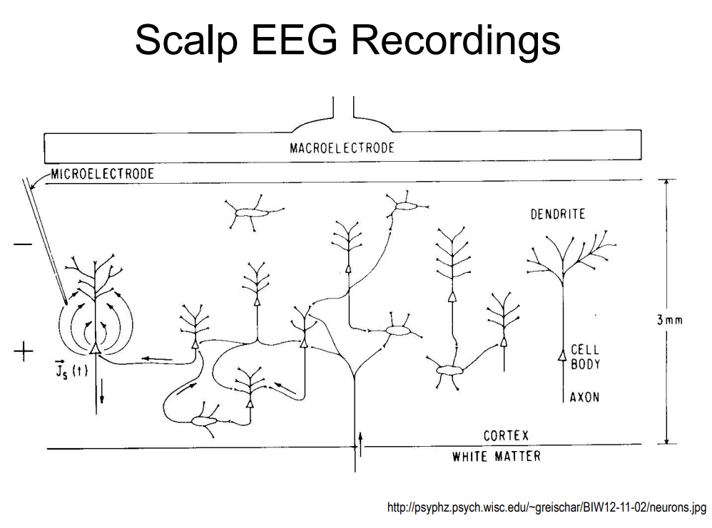
So instead of single neuron recordings, we look at the summed activity of many pyramidal neurons.
Notes:
https://www.mayoclinic.org/tests-procedures/eeg/about/pac-20393875

Slide 34
It is also important to keep in mind that EEG signals result from synchronous activity within the pyramidal neurons.

Slide 35
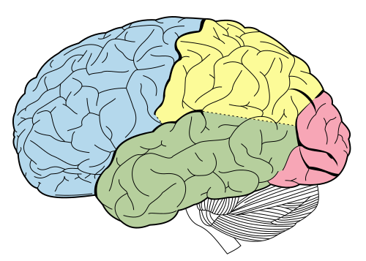
For your BCI project, you are interested in EEG signals specifically coming from the occipital lobe, where visual signals are processed.
Occipital Lobe
Notes:
https://www.wikiwand.com/en/Occipital_lobe

Slide 36
Now we have an idea about where the EEG signal comes from, physiologically.

Slide 37
Now let’s consider the frequency domain features being used in the SSVEP literature we have been reviewing.

Slide 38
Frequency Analysis

Slide 39
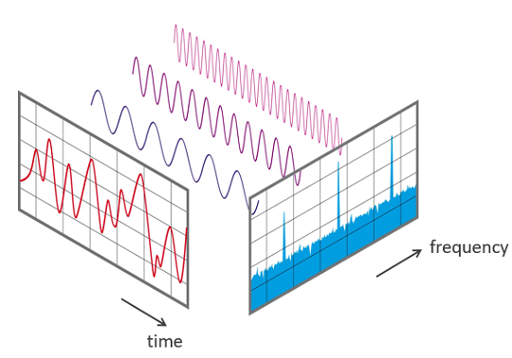
Frequency analysis is a field with which we convert a signal from the time-domain into the frequency domain.
Notes:
https://www.nti-audio.com/en/support/know-how/fast-fourier-transform-fft

Slide 40
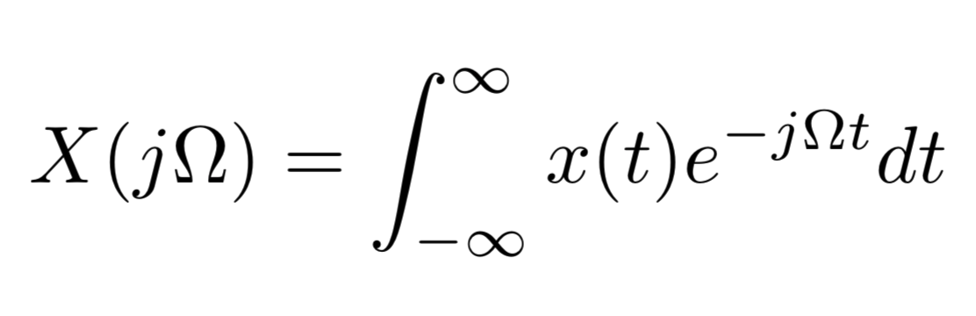
The most often understood method for doing this is known as the Fourier Transform.

Slide 41
Here we have a continuous time signal being transformed into a continuous frequency representation.

Slide 42
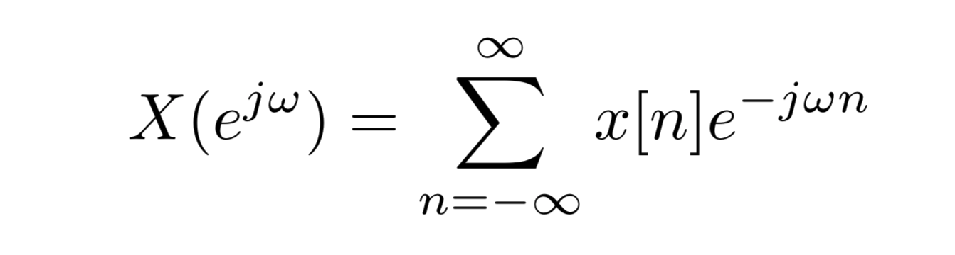
For implementation of the fourier transform, we must consider a different version of this function known as the Discrete Time Fourier Transform (DTFT).

Slide 43
Here we have a discrete time signal being transformed into a continuous frequency representation.

Slide 44
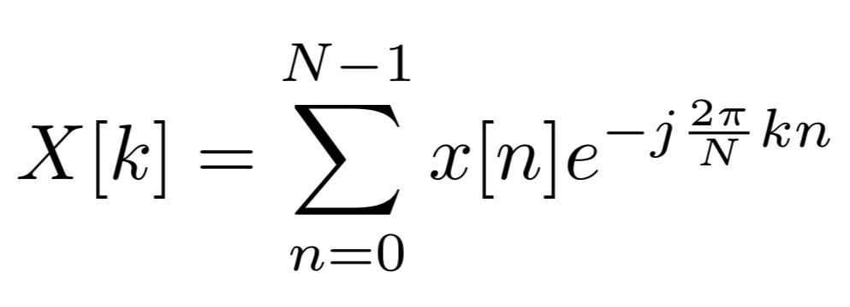
The DTFT can only be implemented in real life by considering samples of the output of the DTFT, which is known as the Discrete Fourier Transform (DFT).

Slide 45
Now, we have a discrete time signal being transformed into a discrete frequency representation.

Slide 46
In order to do frequency-analysis of a real signal, we have to window the signal, and then sample the spectrum with the Discrete Fourier Transform.

Slide 47
The Fast Fourier Transform (FFT) is a method of implementation of the Discrete Fourier Transform.

Slide 48
Any questions about:
Fourier Transform
DFT
DTFT
FFT

Slide 49
Spectral Estimation

Slide 50
In each of these transformations, we are assuming that we have a deterministic signal, meaning that there is no randomness in the realizations of the signal.

Slide 51
In our problem, our signals are inherently random, and as such, we must take that into account when doing frequency analysis.

Slide 52
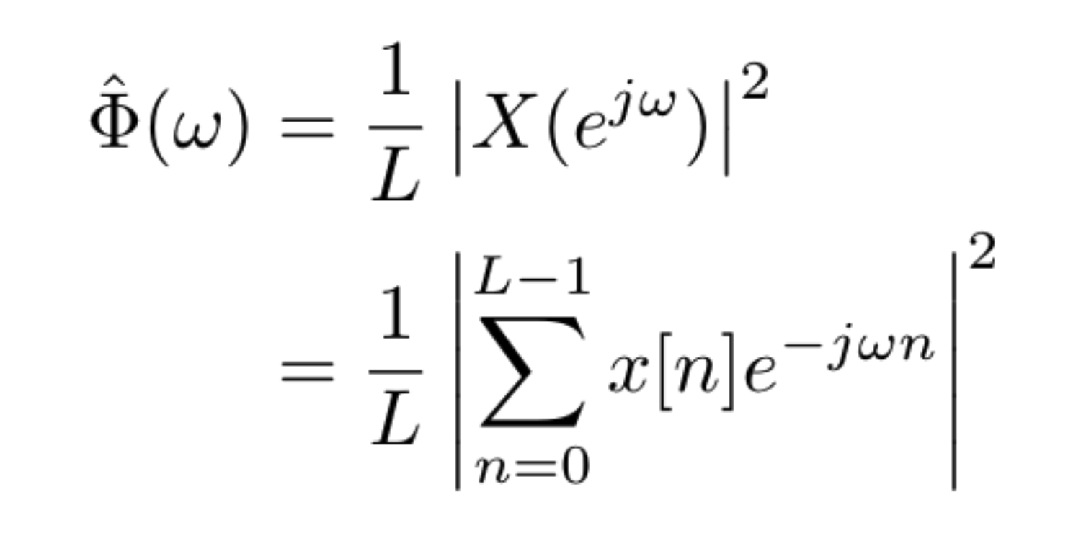
We won’t go exactly into the details, but a method to estimate the power spectral density of random signals is with the periodogram.

Slide 53
The periodogram is the natural way to estimate the power spectral density, but we can do better.

Slide 54
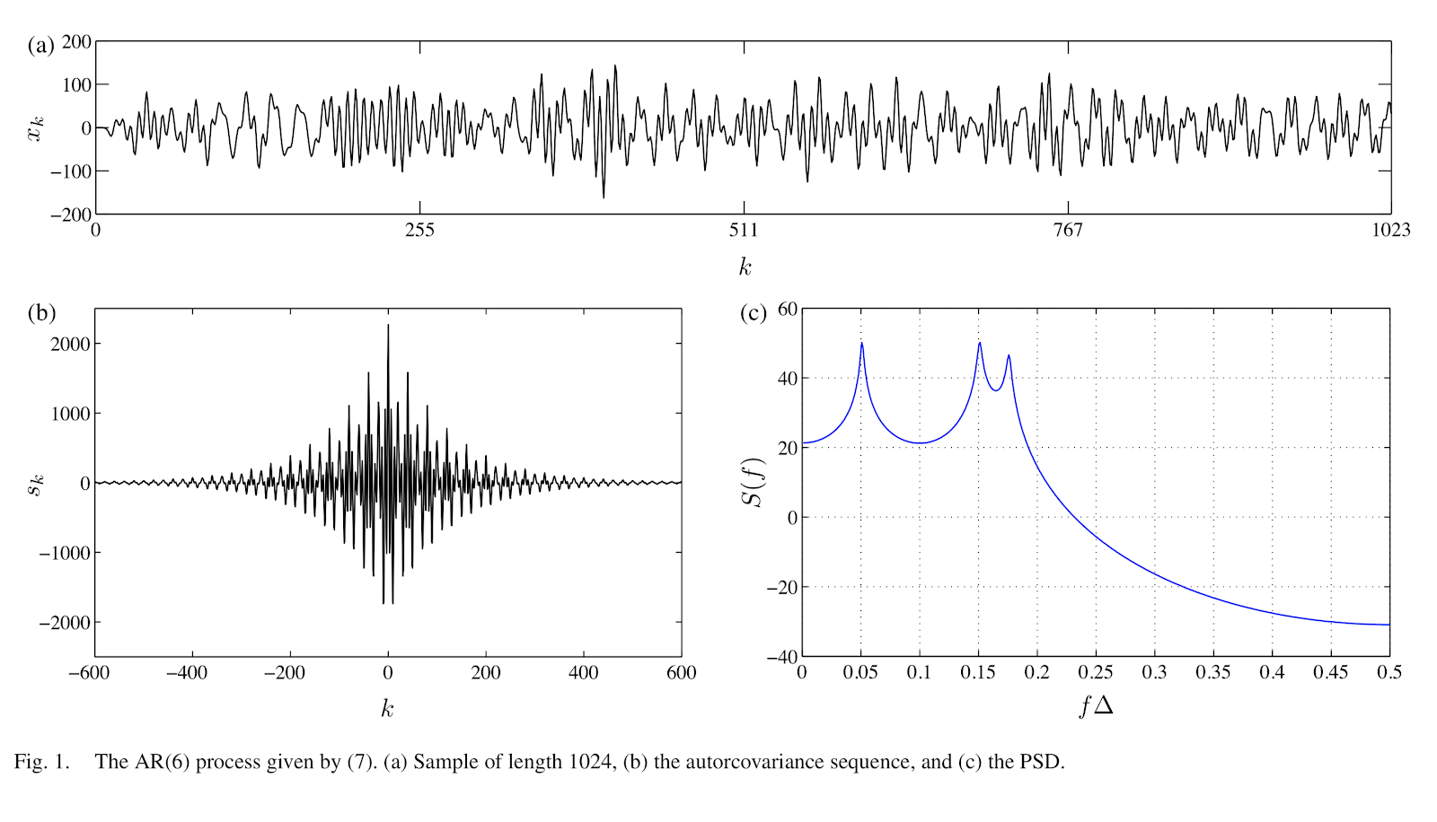
This illustrates an autoregressive process of order 6 used to illustrate the characteristics of the spectral estimation techniques I will show..

Slide 55
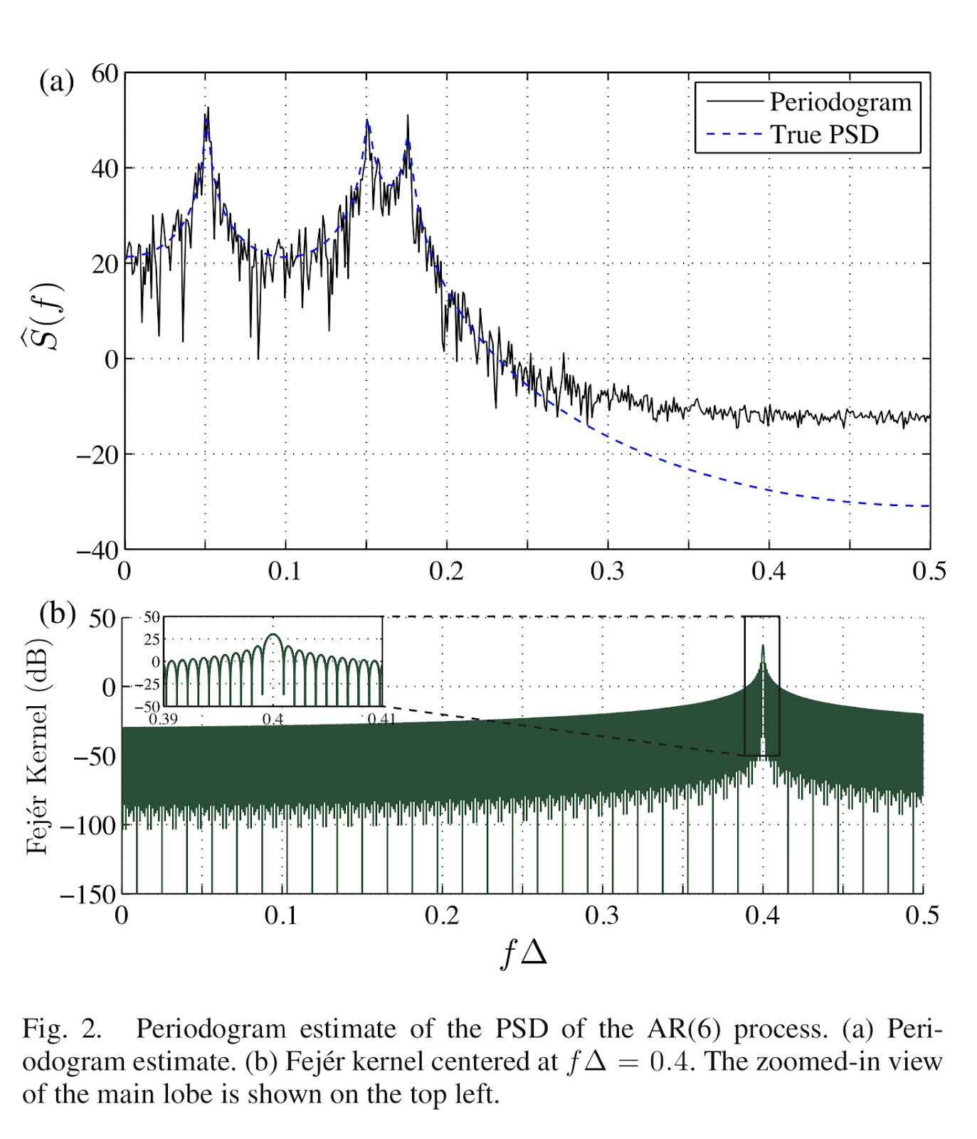
The periodogram is a biased estimate of the PSD because its expected value is the frequency convolution of the true PSD with the DTFT of the autocorrelation of the data window.
Notes:
Section 10.5.2 of Discrete-time Signal Processing by Oppenheim

Slide 56
It is, however, asymptotically unbiased.
Notes:
Section 10.5.2 of Discrete-time Signal Processing by Oppenheim

Slide 57
The variance of the periodogram is asymptotically proportional to the square of the true underlying PSD.

Slide 58
Consequently, the periodogram is asymptotically unbiased but not a consistent estimate.

Slide 59
Consequently, the periodogram hits the peaks pretty well, but is very spiky throughout the estimate.

Slide 60
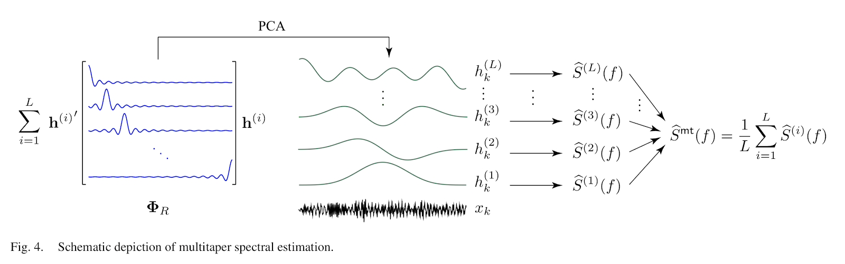
There is a technique known as multitaper spectral analysis which is able to tighten up (reduce the variance) the estimate of the power spectrum.

Slide 61
Given L “good” and “uncorrelated” windows, the multitaper spectral estimate formed by averaging the corresponding L tapered estimates would have a variance reduced by a factor L.

Slide 62
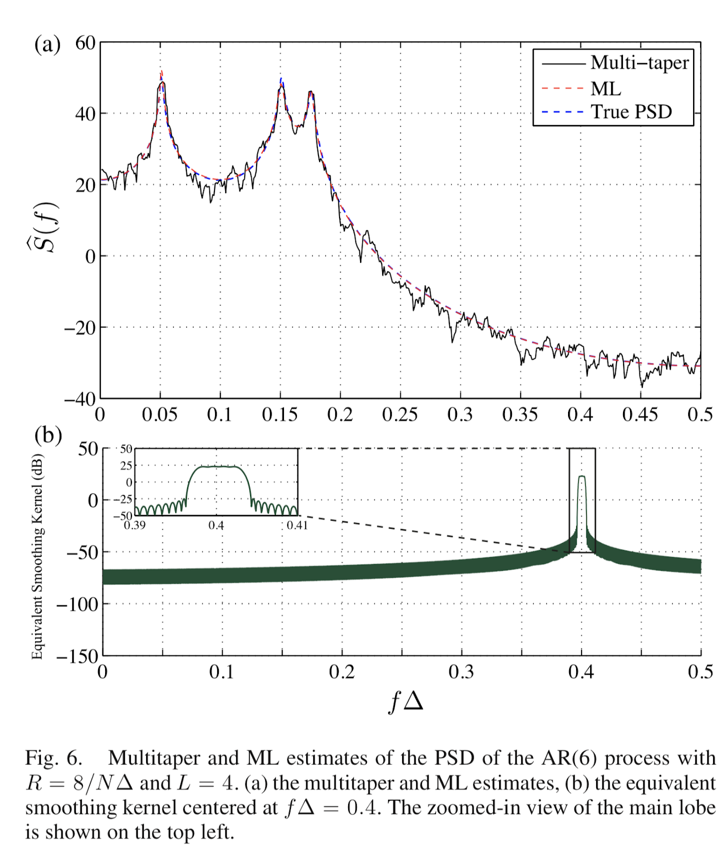
We see a reduction in variance in the resultant spectral estimate.

Slide 63
We have introduced a concept, multitaper frequency analysis which is complex, but quite straightforward to implement.

Slide 64
Interactive Tutorial

Slide 65
Resources Used
Buzsáki, György; Anastassiou, Costas A.; Koch, Christof (2012). The origin of extracellular fields and currents — EEG, ECoG, LFP and spikes. Nature Reviews Neuroscience, 13(6), 407–420. doi:10.1038/nrn3241
https://www.mayoclinic.org/tests-procedures/eeg/about/pac-20393875
https://battlebornbatteries.com/amps-volts-watts/
Britton JW, Frey LC, Hopp JLet al., authors; St. Louis EK, Frey LC, editors. Electroencephalography (EEG): An Introductory Text and Atlas of Normal and Abnormal Findings in Adults, Children, and Infants [Internet]. Chicago: American Epilepsy Society; 2016. Available from: https://www.ncbi.nlm.nih.gov/books/NBK390354/

